Slide 1
PROJECT TITLE
CSE7101- Capstone Project
Review-1
Batch Number:CSE_202
Under the Supervision of
Ms . Shwetha K H
Professor / Associate Professor / Assistant Professor
School of Computer Science and Engineering
Presidency University
Roll Number | Student Name
20221CSE0433 | M Prakash
20221CSE0439 | B Tejeswar Reddy
20221CSE0447 | B Vishnu Vardhan
Name of the Program:: B.Tech(Computer Science And Engineering)
Name of the HoD: Dr. Asif Mohammed
Name of the Program Project Coordinator: Dr. Jayavadivel Ravi
Name of the School Project Coordinators: Dr. Sampath A K , Dr. Geetha A

Slide 2
Problem Statement Number: PSCS_208
Organization: Presidency University
Category (Hardware / Software / Both) :Both
Problem Description: Water scarcity is a major challenge in agriculture, leading to inefficient
water use and reduced crop yields. Traditional irrigation methods often result in
overuse or underuse of water. Description: Develop a smart irrigation system that
utilizes sensors and IoT technology to monitor soil moisture levels and weather
conditions. This system will provide real-time data to farmers, enabling them to
make informed decisions on irrigation scheduling, thus optimizing water usage and
enhancing crop yield. Expected Solution: A smart irrigation module integrated with
moisture sensors and a mobile application to provide farmers with timely irrigation
alerts and recommendations based on real-time data.

Slide 3
Objectives:
  Monitor Soil Moisture and Weather Conditions
  Deploy IoT-based sensors to gather real-time data on soil moisture, temperature, and weather forecasts.
  Automate Irrigation Processes
  Implement automated control of irrigation based on sensor readings and pre-set thresholds, minimizing human intervention.
  Enable Real-Time Monitoring
  Use IoT sensors to collect live data on soil moisture, temperature, humidity, and other environmental parameters.
  Optimize Water Usage
  Reduce wastage and prevent over- or under-irrigation by delivering the right amount of water to crops when needed.
  Automate Irrigation Recommendations
  Use mobile applications to deliver timely alerts and guidance for irrigation based on live sensor data.
  Enable Remote Control and Alerts
  Provide farmers with the ability to control and monitor the system via mobile or web applications, including notifications for critical conditions.

Slide 4
Analysis of Problem Statement
Agriculture plays a critical role in India's food production development. Agriculture in our country is reliant on the monsoons, which provide little water. As a result, irrigation is employed in agriculture. Water is delivered to plants in an irrigation system based on the soil type. Plant humidity and temperature are accurately managed with this method. Due to varying atmospheric conditions, these variables might change from place to place in a large farmhouse, making it difficult to maintain consistency at all points across the farmhouse manually. We should also know the right crop to grow at right time of the season and looking at the atmospheric parameter. The major goal of this research is to create a smart wireless sensor network for use in an agricultural setting. It is important to monitor the agricultural environment for numerous parameters such as soil moisture, temperature, and humidity, as well as other factors of water level present in the environment and condition of water for giving it to plants

Slide 5
Github Link
https://github.com/vishnuvardhanjune24-arch/smart-irriation

Slide 6
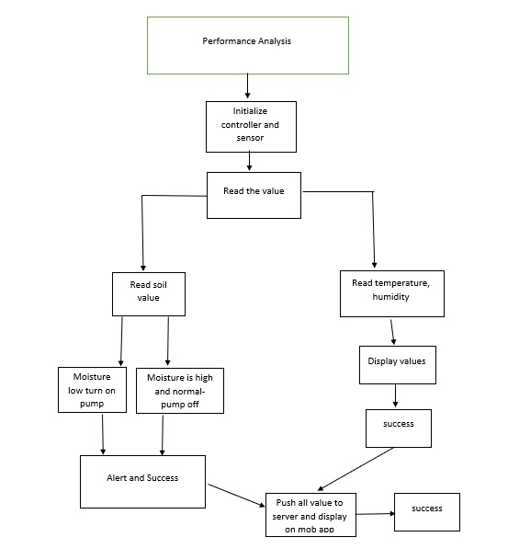
Overview:

Slide 7
Analysis of Problem Statement (contd...)
Hardware Requirements:
Field Sensors (measure soil & environment)
Actuators & Irrigation Hardware
Power System
Software Requirements:
Firmware / Edge Software
Front-end(Mobile app)

Slide 8
Innovation or Novel Contributions
Integration of IoT and Weather Forecasting:
Unlike basic irrigation timers, the proposed system uses real-time sensor data along with weather predictions to make intelligent irrigation decisions
b. Crop-Specific Irrigation Algorithms:
  The system allows customization of moisture thresholds and watering schedules based on crop type and growth stage.
c. Mobile App with Real-Time Alerts and Recommendations:
Farmers receive instant notifications about soil moisture status and irrigation needs, enabling timely action without constant manual monitoring.

Slide 9
Timeline of the Project (Gantt Chart)
Phase 1 – Research & Design
Phase 2 – Implementation & Integration
Phase 3 – Testing, Evaluation & Finalization

Slide 10
References :
Patil, S. P., & Kale, R. B. (2021). Smart irrigation system for precision agriculture using IoT and cloud computing. International Journal of Innovative Technology and Exploring Engineering (IJITEE)
Mahalle P.N, Shinde, V., & Deshpande, V. (2020). Precision irrigation using IoT for water-efficient farming. International Journal of Advanced Science and Technology
Prathibha, S. R., Hongal, A., & Jyothi, M. P. (2017). IoT based monitoring system in smart agriculture.

Slide 11


